Slide 1
to a Critical Stakeholders Meeting on Plans & Modalities for the Sale & Registration of 2018 UTME Application
Wednesday, 15th November, 2017

Slide 2
STAKEHOLDERS
National Assembly
Educational Institutions / Regulatory Agencies
CBT Centres (Public & Private)
Parents (NAPTAN)
Teachers (ANCOPSS)
Candidates
Labour (ASUU/ASUP/COEASU/NASU)
Students (NANS)
Civil Society Groups & Media

Slide 3
For 2017 UTME
For the 2017 Registration exercise, ePINs were sold through Banks and partner Institutions
JAMB implemented a central ePIN vending system
Other channels employed included switches like Remitta & Interswitch
Registration was essentially for a period of one month (with 2 weeks Federal House of Representative extension)

Slide 4
Observed/Abuse for the 2017 UTME by CBT Centres
Extortion of candidates during profile/email creation at cyber cafes
Sale of eBrochure & eSyllabus CDs to candidates meant to be free
Collection of gate fee at CBT Centres
Sale of Reading Text
Usage of CBT centre emails & Telephone numbers for candidates

Slide 5
Observed/Abuse for the 2017 UTME by CBT Centres (cont’d)
CBT Extortion of candidates – charging fees above the approved rate
Subletting Access Codes to cyber cafes
Going outside their registered locations to register candidates, on & off line
Dualisation of biometric capturing to multiple persons thereby encouraging Multiple Registration

Slide 6
For the Coming Examination
Candidates can start registration from home to
prevent extortion

Slide 7
Prospective Candidates are expected to have visited the JAMB Website ahead of Registration to study 2018 ebrochure
www.jamb.gov.ng

Slide 8
REGISTRATION PROCESS Profile Creation from Home by Candidates Using Cellphones – Text (SMS)
Sends his/her Surname, First Name & Middle Name (where applicable). This should be maximum of 38 characters + 2 spaces between names = 40 characters in all to JAMB short code of 55019
One cell number (mobile number) can be used by one candidate only
A confirmation code of 10 characters is received by the candidate on the same telephone number which will be used to procure the ePIN

Slide 9
PROFILE SELF HELP IN CASE OF MISTAKE / LOSS
To correct a mistake in candidate’s name, resend a text message (from the registered number) “CORRECT Surname First name Middlename” to 55019
To retrieve a lost confirmation code, resend a text message (from the registered number) “RESEND” to 55019

Slide 10
JAMB ePIN SELLING POINTS
Participating Banks
Mobile Money Operators including eTranzact
(Paga, Cellulant, Teasy Mobile e.t.c.)
Registered Microfinance Banks –
(Ifesowapo, Regent, FUDMFB, Welfare MFB)
Online Payment – Remita & Interswitch (Switches)
POS (Citi-Serve)
ATM (Interswitch)
USSD (NIBSS & ERCAS) – for mobile (Internet/online) banking

Slide 11
Duties of Participating Financial Institutions at the CBT Centres
Collect the confirmation code from candidates phone
Collect payment and issue ePINs
Facilitate POS Payments if necessary
Provide Evidence of Payments
Collection of Centre Service Fees if requested by the Centre

Slide 12
PAYMENT THROUGH BANKS INCLUDING MICROFINANCE BANKS
Present confirmation code and pay by cash or card
ePIN is delivered to the candidate’s unique telephone number

Slide 13
PAYMENT THROUGH POS (CITI-SERVE)
This is available at State Offices of JAMB + CBT Centres, Other POS Outlets & any CBT Centre that demands it
Present confirmation code & pay by card
ePIN is then delivered to the candidate’s unique telephone number

Slide 14
PAYMENT THROUGH MOBILE MONEY OPERATORS INCLUDING eTranzact
This is available at CBT Centres & Other Agent Outlets
Present confirmation code & pay by cash
ePIN is then delivered to the candidate’s unique telephone number

Slide 15
PAYMENT USING ATM
This is available at all ATM outlets of participating Banks (Interswitch Channel)
Select Bill Payment & then pick JAMB
Enter confirmation code & pay
ePIN is then delivered to the candidate’s unique telephone number

Slide 16
ONLINE PAYMENTS USING REMITA / INTERSWITCH
Log on to JAMB website: www.jamb.gov.ng
Click Registration
Enter confirmation Code
Select payment Method e.g. Interswitch or Remita
Make payment
ePIN is then delivered to the candidate’s unique telephone number

Slide 17
PAYMENTS USING USSD (NIBSS / ERCAS)
Dial USSD code (e.g. *565*6#)
Enter confirmation code
Select bank & follow the prompts to complete payment
ePIN is then delivered to the candidate’s unique telephone number

Slide 18
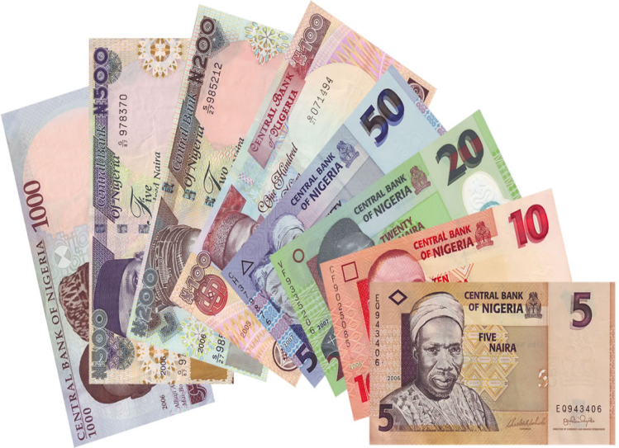
PAYMENT SELF HELP
If ePIN is not Received or Lost , send a text message from the registered telephone number “UTMEPIN” or “DEPIN” to 55019 for UTME or DE respectively
The ePIN would then be retrieved

Slide 19
After payment…
After successful payment & obtaining ePIN, candidate should proceed to any of the accredited CBT Centres to complete his/her own registration

Slide 20
REGISTRATION PROCESS At CBT Centres
The candidate presents the ePIN at any JAMB accredited CBT Centre for validation and completion of registration
Candidate is expected to pay not more than N700.00 as Service Charge to the CBT Centre
Provides biodata
choice of institutions and programmes
UTME subjects
Picture capture (no passport photography
Biometric capture
Print Registration Slip using biometric authentication
Collect reading text & CD

Slide 21
Payment & Registration Flow
Use text to create profile from your phone
(only one number per candidate)
Receive confirmation code in your phone
Buy form ePIN using the code in your phone
Register with your ePIN at any CBT Centre
55019
Tinubu Adamu Rochas
Participating Banks
Mobile Money Operators
Registered Microfinance
Online Payment
POS
ATM
USSD
650
CBT Centres

Slide 22
conclusion

